Slide 1
Data Science Accelerator
Launch Session [Date]
Notes:
Introduce the team

Slide 2
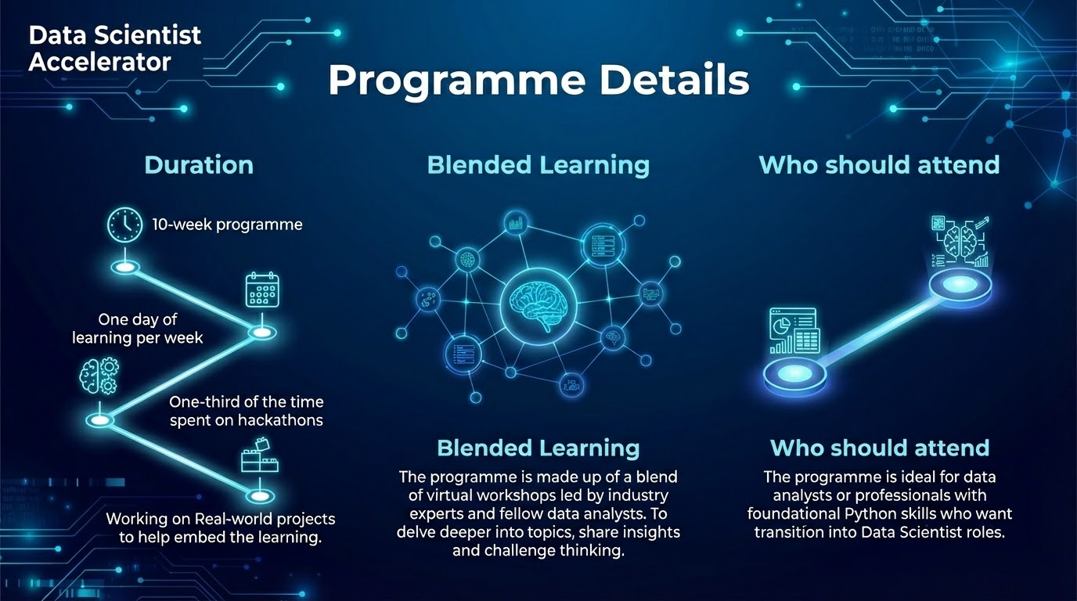
Notes:
2 mins - Provide a high level overview of what to expect from the programme. Decoded will go into the lower level detail and timetable.

Slide 3




Programme Overview
Date
Date
Date
(TBD)
Date
Programme Launch
Mid Programme Review
Graduation
Review
25 Participants successfully start on the programme, weekly feedback and supplier reviews
Collate feedback from both participants and line managers. As part of the programmes continuous improvements mechanism
Cohort Graduation a chance for the participants to celebrate their success in front of their peers and line managers
Programme review and lessons learnt to inform the next cohort
Notes:
Time: 2 mins
Programme Overview: Provide an overview of the Key activities of the programme and start date.

Slide 4


Data Science Accelerator.
Notes:
Point
The purpose of this slide is to <introduce todays topic>
Narrative
Transition
[NS: ]

Slide 5


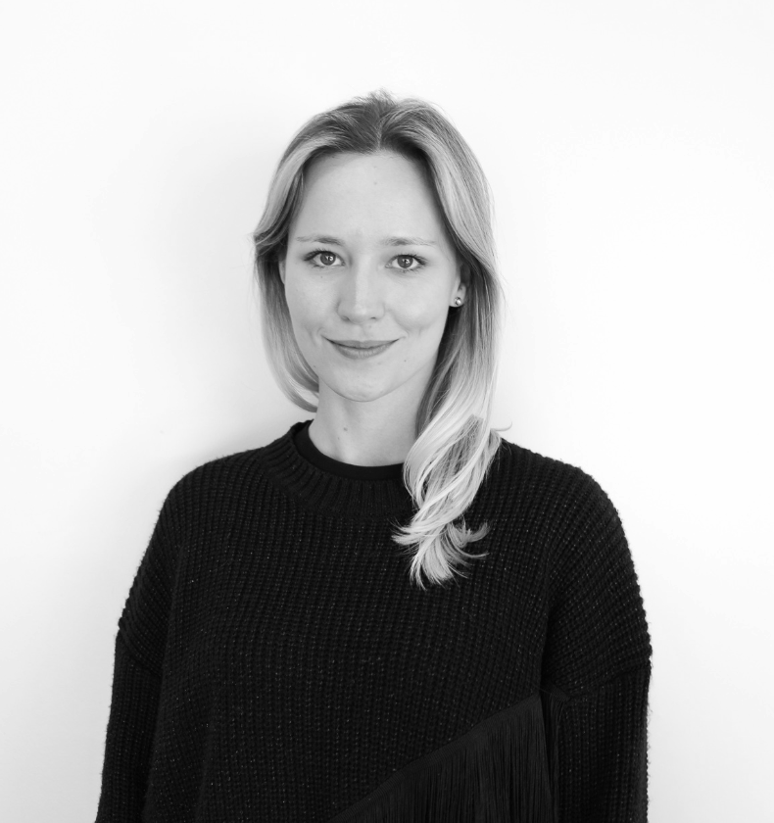
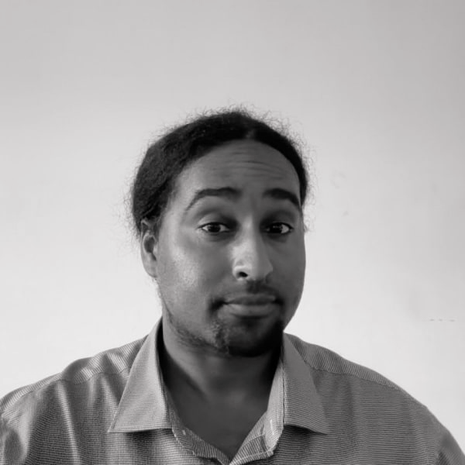

Your Decoded Team
Karl Lacey
Client Director
Sophie McMurray
Portfolio Director
Boston
Data Instructor
James
Data Instructor
Notes:
Timing: Slides 1-5 [16:30 - 16:40]
Point: Setting expectations
Narrative
Show & Tell:
After the launch today you will have 8 weeks of workshops
One 3 hour workshop every thursday
As this is a technical program, during the workshops you’ll work with variety of tools
All the tools have been installed for you on a virtual desktop environment
Access on workshop days, for the whole day
Allows you time to practice before and after sessions
Time to work on the project you will complete for the end of the program
You’ll end the program with a graduation on Wednesday 13th November.
It’s very important you join these sessions live and with your cameras on
If you can’t join a session live, you should let us know as soon as you can
Recordings will be uploaded a day or two following workshops, make sure to catch up asap
This is important to make sure you successfully complete the program with a badge.
To get the most out of the program it’s important that you engage with the teacher and your peers
We encourage questions, you can interrupt us at any time, raise a hand in zoom or write a comment in the chat.
Practice it to check it works for everyone
Please don’t hesitate to ask for help when you need it, we are here to support you throughout the duration of your program.
There is also a Decoded Help Centre which you can use for support which I will talk a bit more about today.
[If Molly is present] Before I introduce the Decoded team, we have Molly from Aviva who would like to say a few words.
Transition:
So who are your Decoded team…
[NS: Your program team]

Slide 6
I C E B R E A K E R
menti.com
ID: 2811 0684
Notes:
Point
Establish current learner comfort-level with the material
Narrative
LOAD and present the Menti poll, and UPDATE this slide with the code.
DIRECT learners to menti.com on their phone or computer and ask them to enter the code.
ADAPT to the situation if Menti is blocked for the learners; ask the questions and collect in-person responses.
ENCOURAGE participation using the Menti poll.
ASSESS current learner comfort and understanding of the introductory material.
GATHER learner questions about the topic to answer later.
ANSWER any current questions.
Transition
Let’s talk about the plan for today

Slide 7
Launch Objectives
#1 Build connections with Decoded team and fellow participants
#2 Understand the key components and structure of the programme
#3 Understand the learning platforms and approach
Notes:
Timing: Slides 1-5 [16:30 - 16:40]
Point: Introduce the expected objectives of the session.
Transition:
Let’s get started!
[NS: Meet & greet]

Slide 8
#1
Programme structure.
Notes:
Point
00:30
The purpose of this slide is to <introduce the section on….>
Narrative
Transition
[NS: ]

Slide 9
Programme Deep Dive
Week | 1 | 2 | 3 | 4 | 5
Live date | [Date] | [Date] | [Date] | [Date] | [Date]
Theme | Foundations | Python Data Analysis | Exploratory Data Analysis | Statistical Data Analysis | Capstone Intro
Topics | Launch Tech Demos Foundations Intro Python | Data Manipulation with Pandas | Data Cleaning Data Visualisation Basic preprocessing for Data Science | Introduction to Statistics Hypotheses & Inference Feature Selection | Capstone ideas Initial steps Introduction to version control and dependency management
Notes:
Timing: Slides 1-5 [16:30 - 16:40]
Point: Setting expectations
Narrative
Show & Tell:
After the launch today you will have 8 weeks of workshops
One 3 hour workshop every thursday
As this is a technical program, during the workshops you’ll work with variety of tools
All the tools have been installed for you on a virtual desktop environment
Access on workshop days, for the whole day
Allows you time to practice before and after sessions
Time to work on the project you will complete for the end of the program
You’ll end the program with a graduation on Wednesday 13th November.
It’s very important you join these sessions live and with your cameras on
If you can’t join a session live, you should let us know as soon as you can
Recordings will be uploaded a day or two following workshops, make sure to catch up asap
This is important to make sure you successfully complete the program with a badge.
To get the most out of the program it’s important that you engage with the teacher and your peers
We encourage questions, you can interrupt us at any time, raise a hand in zoom or write a comment in the chat.
Practice it to check it works for everyone
Please don’t hesitate to ask for help when you need it, we are here to support you throughout the duration of your program.
There is also a Decoded Help Centre which you can use for support which I will talk a bit more about today.
[If Molly is present] Before I introduce the Decoded team, we have Molly from Aviva who would like to say a few words.
Transition:
So who are your Decoded team…
[NS: Your program team]
"Let’s take a deep dive into the first half of the curriculum. We go live on Thursday, the 29th of January. We begin with 'Data Science Foundations' and 'Python Data Processing'. We start here because Python is the industry-standard language for data science, and we need to ensure everyone is fluent in the basics before we advance.
Over the first five weeks, we will progress through Exploratory Data Analysis—learning how to 'interview' your data to find patterns—and an Introduction to Statistics. We wrap up this first block on the 26th of February. At this point, you will have your first project release, which is a chance to consolidate everything you have learned so far into a practical piece of work."

Slide 10
Programme Deep Dive
Week | 6 | 7 | 8 | 9 | TBC
Live date | [Date] | [Date] | [Date] | [date] | TBC
Theme | Machine Learning | Classification | Time Series Analysis | Capstone Project | Graduation
Topics | ML Foundations Intro. to Regression | Intro. to Classification› | Time Series with Pandas Time Series Analysis | A chance to begin working work your ML project | Celebrate achievements Present projects
Notes:
Timing: Slides 1-5 [16:30 - 16:40]
Point: Setting expectations
Narrative
Show & Tell:
After the launch today you will have 8 weeks of workshops
One 3 hour workshop every thursday
As this is a technical program, during the workshops you’ll work with variety of tools
All the tools have been installed for you on a virtual desktop environment
Access on workshop days, for the whole day
Allows you time to practice before and after sessions
Time to work on the project you will complete for the end of the program
You’ll end the program with a graduation on Wednesday 13th November.
It’s very important you join these sessions live and with your cameras on
If you can’t join a session live, you should let us know as soon as you can
Recordings will be uploaded a day or two following workshops, make sure to catch up asap
This is important to make sure you successfully complete the program with a badge.
To get the most out of the program it’s important that you engage with the teacher and your peers
We encourage questions, you can interrupt us at any time, raise a hand in zoom or write a comment in the chat.
Practice it to check it works for everyone
Please don’t hesitate to ask for help when you need it, we are here to support you throughout the duration of your program.
There is also a Decoded Help Centre which you can use for support which I will talk a bit more about today.
[If Molly is present] Before I introduce the Decoded team, we have Molly from Aviva who would like to say a few words.
Transition:
So who are your Decoded team…
[NS: Your program team]
Moving into the second half of the programme, things get technically advanced and, frankly, very exciting. From the 5th of March, we tackle Machine Learning. This isn't just theory; you will be building models for Regression (predicting numbers), Classification (sorting data into categories), and Time Series Analysis (forecasting future trends).
This all builds towards your Capstone Project in late March. The Capstone is your opportunity to apply these advanced techniques to a problem that matters to you or your department. The programme officially concludes with your graduation celebration on Thursday, the 28th of May, where we will celebrate the journey you have completed."

Slide 11
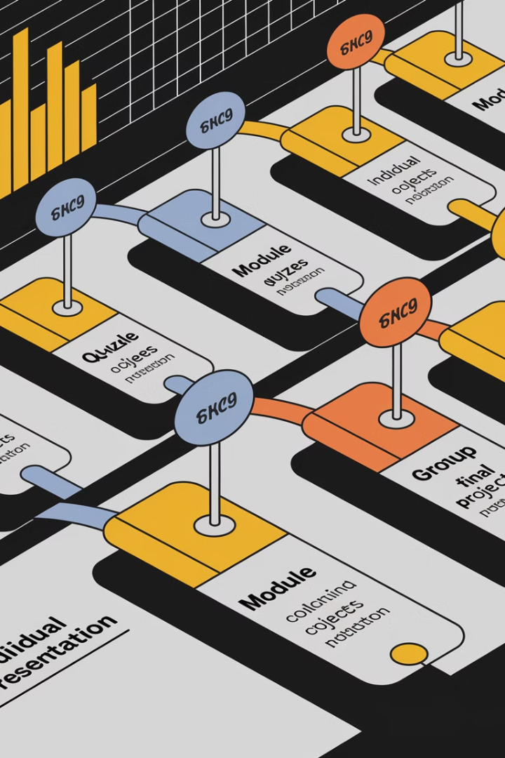
A day in the life
0915
Prepare for the start of the day
Connect to teams, open your remote desktop, and review the pre-released agenda.
0930
Live delivery starts promptly at 09:30
We cycle between about 30 min delivery, about 20 exercises, with 10 minute breaks per subtopic.
1230
An hour for lunch at 12:30 - 13:30
We take lunch at 12:30 (alterable on request), and return in an hour.
1630
Live delivery ends by 16:00 - 16:30
During this time period we will conclude the session and allow time for the feedback form to be filled

Slide 12
Milestones & Assessments
1
Individual Projects
Demonstrate practical skills and problem-solving abilities through independent projects.
2
Group Challenges
Collaborative efforts that showcase teamwork, communication, and shared problem-solving.
3
Final Presentation
Presentation of individual projects, showcasing the results and insights gained. Within

Slide 13



Tools & Course Materials
Hardware & Software
Throughout the duration of the programme you will have access to a development environment via a browser URL that will be provided for you. All essential course materials and software will be available to you in this environment.
Live Sessions on Teams
All live sessions will be hosted on Microsoft Teams, your cohort has a dedicated channel which we will use for continuous communication and file sharing. When necessary, you can access session recordings through the Teams channel.

Slide 14
#2
Programme goals.
Notes:
Point
1:00
The purpose of this slide is to <introduce the section on….>
Narrative
Transition
[NS: ]

Slide 15

Programme Goals
The programme is designed to upskill Data Analysts into Data Scientists with the following capabilities and competencies:
Translate business questions into predictive modelling problems aligned to real-world objectives.
Apply Python-based data science workflows, using libraries for data preparation, modelling and experimentation.
Design, train and validate machine learning models.
Evaluate model performance and limitations, recognising issues such as overfitting and bias.
Interpret and communicate results, including probabilities, confidence, and trade-offs, to both technical and non-technical stakeholders.

Slide 16

Data Analyst
Data Scientist
Data Analysts primarily work closely with stakeholders to translate business questions into analytical tasks, clean and explore data, and apply descriptive and diagnostic techniques to uncover trends, patterns, and anomalies.
Data Analysts commonly use tools such as Excel spreadsheets and business intelligence platforms like Power BI or Tableau to create dashboards and reports.
Data Scientists extend their focus to predictive and prescriptive analytics. They design and build statistical and machine learning models to predict outcomes, quantify uncertainty, and evaluate different scenarios to support decision-making.
Data Scientists typically work with Python using libraries such as pandas, NumPy and machine learning frameworks, alongside notebooks and version control platforms like GitHub.

Slide 17






Programme Approach
Learning Centred
Live virtual
Active Learning
you will complete a feedback form at the end of each workshop. Allowing us to improve based on your feedback.
Live sessions occur one full day a week, please do your best to attend. Attendance will be tracked and monitored.
We have formatted the session in a way that will allow for you to practice the concepts as soon as you learn them.
Tutor support
Course materials
Support throughout the programme from DWP and Decoded via Teams
Stay up to date with the recordings, assignments and resources available on our labs, Canvas and Teams
Notes:
Timing: Slides 1-5 [16:30 - 16:40]
Point: Setting expectations
Narrative
Show & Tell:
After the launch today you will have 8 weeks of workshops
One 3 hour workshop every thursday
As this is a technical program, during the workshops you’ll work with variety of tools
All the tools have been installed for you on a virtual desktop environment
Access on workshop days, for the whole day
Allows you time to practice before and after sessions
Time to work on the project you will complete for the end of the program
You’ll end the program with a graduation on Wednesday 13th November.
It’s very important you join these sessions live and with your cameras on
If you can’t join a session live, you should let us know as soon as you can
Recordings will be uploaded a day or two following workshops, make sure to catch up asap
This is important to make sure you successfully complete the program with a badge.
To get the most out of the program it’s important that you engage with the teacher and your peers
We encourage questions, you can interrupt us at any time, raise a hand in zoom or write a comment in the chat.
Practice it to check it works for everyone
Please don’t hesitate to ask for help when you need it, we are here to support you throughout the duration of your program.
There is also a Decoded Help Centre which you can use for support which I will talk a bit more about today.
[If Molly is present] Before I introduce the Decoded team, we have Molly from Aviva who would like to say a few words.
Transition:
So who are your Decoded team…
[NS: Your program team]

Slide 18

Expectations
Attendance
Cameras on
Participate
Live sessions occur one to two full days a week, please do your best to attend. Attendance will be tracked and monitored.
To close the digital gap, cameras matter. Please have cameras on and get support if you have any technical issues.
Active participation is key, engage in discussions, ask questions and contribute to group challenges and collaborative projects.
Ask for help
Course materials
Self directed study
If you have any issues please let the Decoded or Civil Service team know, we are here to help.
Stay up to date with the recordings, assignments and resources available on the Labs, Canvas and Teams.
Dedicate time each week to consolidate what you’ve learned from the workshop.
Notes:
Timing: Slides 1-5 [16:30 - 16:40]
Point: Setting expectations
Narrative
Show & Tell:
After the launch today you will have 8 weeks of workshops
One 3 hour workshop every thursday
As this is a technical program, during the workshops you’ll work with variety of tools
All the tools have been installed for you on a virtual desktop environment
Access on workshop days, for the whole day
Allows you time to practice before and after sessions
Time to work on the project you will complete for the end of the program
You’ll end the program with a graduation on Wednesday 13th November.
It’s very important you join these sessions live and with your cameras on
If you can’t join a session live, you should let us know as soon as you can
Recordings will be uploaded a day or two following workshops, make sure to catch up asap
This is important to make sure you successfully complete the program with a badge.
To get the most out of the program it’s important that you engage with the teacher and your peers
We encourage questions, you can interrupt us at any time, raise a hand in zoom or write a comment in the chat.
Practice it to check it works for everyone
Please don’t hesitate to ask for help when you need it, we are here to support you throughout the duration of your program.
There is also a Decoded Help Centre which you can use for support which I will talk a bit more about today.
[If Molly is present] Before I introduce the Decoded team, we have Molly from Aviva who would like to say a few words.
Transition:
So who are your Decoded team…
[NS: Your program team]

Slide 19

Set Personal Learning Goals
1
Identify Strengths
Reflect on your existing skills and areas where you excel.
2
Areas for Improvement
Identify specific skills or knowledge gaps you want to address.
3
Measurable Goals
Set clear objectives that can be tracked and evaluated over time.
Submit
4
Submit your personal learning goals statement on Teams.

Slide 20
#3
Learning support.
Notes:
Point
1:30
The purpose of this slide is to <introduce the section on….>
Narrative
Transition
[NS: ]

Slide 21







Support
Teachers
Peers
Teams
Decoded teachers deliver engaging and interactive live sessions, actively participate, answer and ask questions.
Opportunities to learn from and collaborate with peers through live group discussions and collaborative projects.
Resources are available on Teams alongside chat functionality to discuss share knowledge, insights, and challenges with peers.
Technology Team
DWP
Networking
Decoded’s technology team is available to provide troubleshooting and technical support if and when you need it.
Be transparent and actively seek support from your line manager and organisation to balance your responsibilities.
Connect with peers, industry professionals, and mentors who can enhance your learning and long-term career growth.
Notes:
Timing: Slides 1-5 [16:30 - 16:40]
Point: Setting expectations
Narrative
Show & Tell:
After the launch today you will have 8 weeks of workshops
One 3 hour workshop every thursday
As this is a technical program, during the workshops you’ll work with variety of tools
All the tools have been installed for you on a virtual desktop environment
Access on workshop days, for the whole day
Allows you time to practice before and after sessions
Time to work on the project you will complete for the end of the program
You’ll end the program with a graduation on Wednesday 13th November.
It’s very important you join these sessions live and with your cameras on
If you can’t join a session live, you should let us know as soon as you can
Recordings will be uploaded a day or two following workshops, make sure to catch up asap
This is important to make sure you successfully complete the program with a badge.
To get the most out of the program it’s important that you engage with the teacher and your peers
We encourage questions, you can interrupt us at any time, raise a hand in zoom or write a comment in the chat.
Practice it to check it works for everyone
Please don’t hesitate to ask for help when you need it, we are here to support you throughout the duration of your program.
There is also a Decoded Help Centre which you can use for support which I will talk a bit more about today.
[If Molly is present] Before I introduce the Decoded team, we have Molly from Aviva who would like to say a few words.
Transition:
So who are your Decoded team…
[NS: Your program team]

Slide 22

Reasonable adjustments
1
Recordings
2
Pre-release of materials
Recordings with immediate release on teams.
Assets will be available via the labs.
3
Regular breaks
4
Post-release of materials
Ask for breaks, and we will aim to schedule one every hour.
Live assets created during delivery will be released afterwards.

Slide 23
Q U I Z
menti.com
ID: 4543 1576
Notes:
Point
Establish current learner comfort-level with the material
Narrative
LOAD and present the Menti poll, and UPDATE this slide with the code.
DIRECT learners to menti.com on their phone or computer and ask them to enter the code.
ADAPT to the situation if Menti is blocked for the learners; ask the questions and collect in-person responses.
ENCOURAGE participation using the Menti poll.
ASSESS current learner comfort and understanding of the introductory material.
GATHER learner questions about the topic to answer later.
ANSWER any current questions.
Transition
Let’s talk about the plan for today

Slide 24
Key takeaways.
A 10-week immersive programme featuring live sessions one full day a week with self-paced and collaborative projects. Success comes from active participation, consistent engagement, and applying your skills through practice.
The programme equips learners with Data Science skills to move beyond reporting and analysis, and begin predicting outcomes and informing decisions with data.
Successful learning and career growth stem from proactive planning, seeking support when needed, and building meaningful connections.
Notes:
Point
The purpose of this slide is to <summarise the key takeaways of the entire session>
Narrative
Transition
[NS: ]

Slide 25
Questions?
Notes:
Point
The purpose of this slide is to <wrap up the session and ask learners to complete feedback forms>
Narrative
Transition
[NS: ]

Slide 26
please contact the team directly at the email addresses below:
Thank you
ai-accelerator@dsit.gov.uk
Notes:
Time 5 mins Q&A
Speaker Notes: Anna
Open the floor for Questions:
If you want any further information or you have any questions please feel free to contact us at the e mail addresses shown
Thankyou - Mic Drop :)

Slide 27

Take
a break.

Slide 28
Teams Demo

Slide 29
Canvas Demo

Slide 30
Labs Demo

